Slide 1
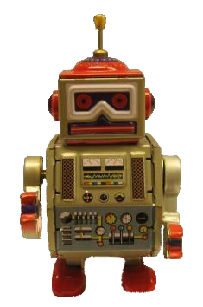
Robot Framework
A generic framework for
acceptance testing
Maarten
Vandersteegen

Slide 2
Why?

Slide 3
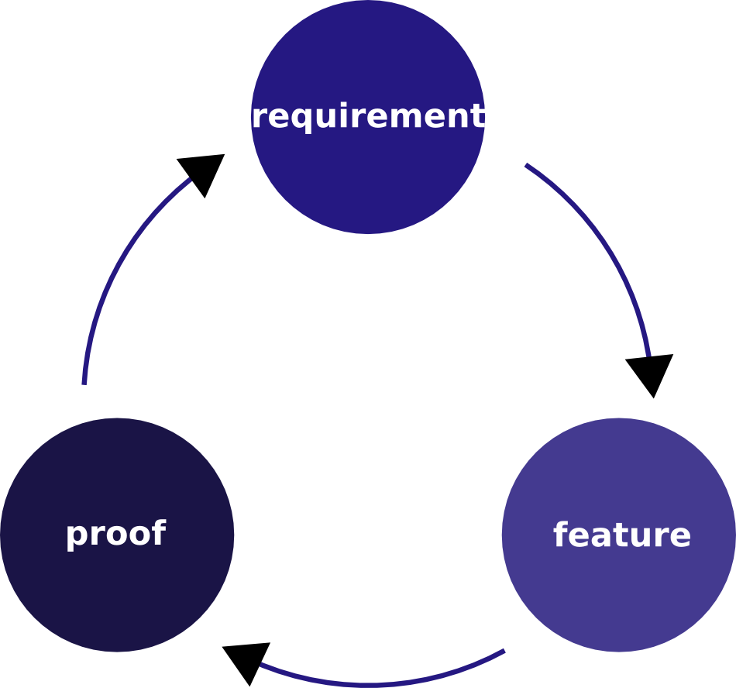
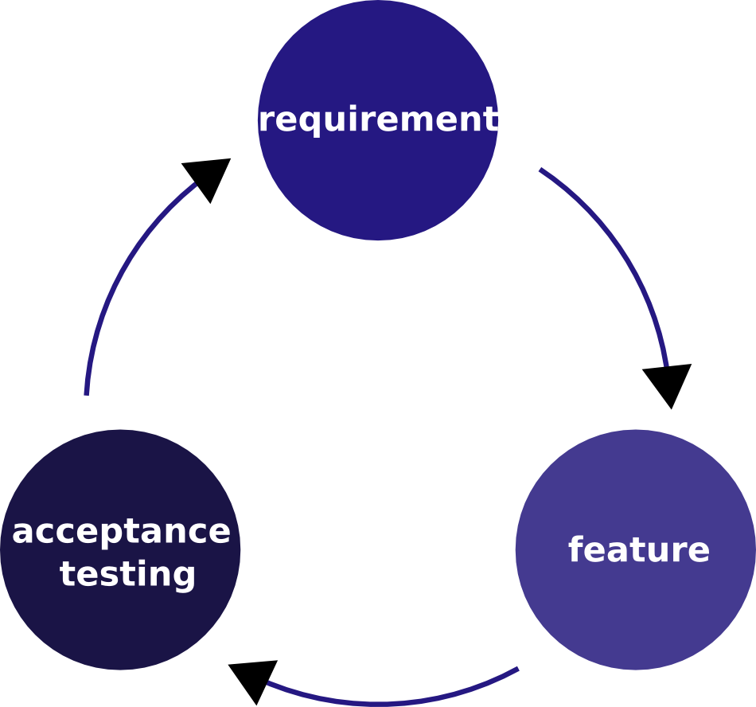

Slide 4
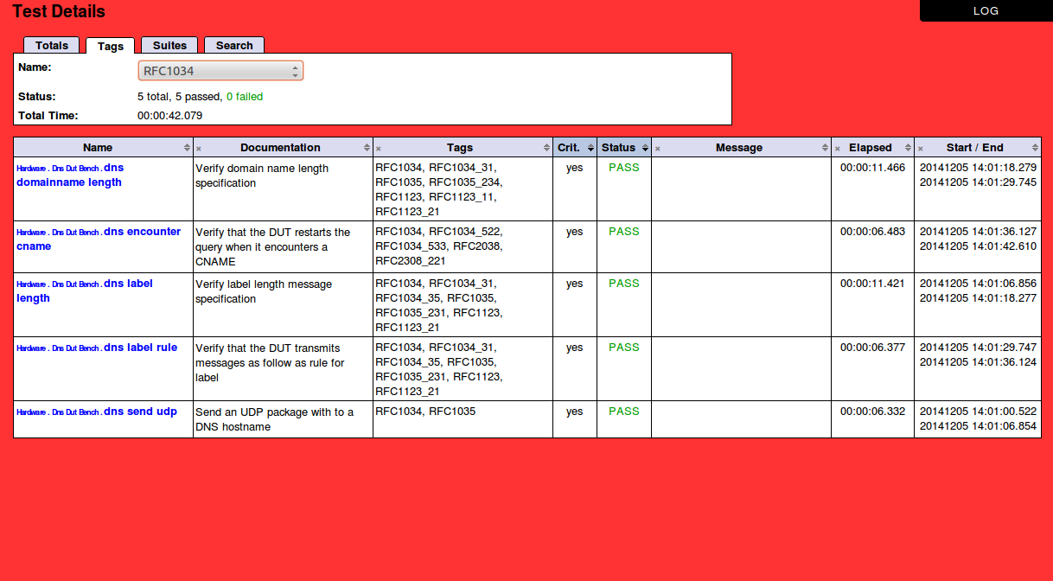
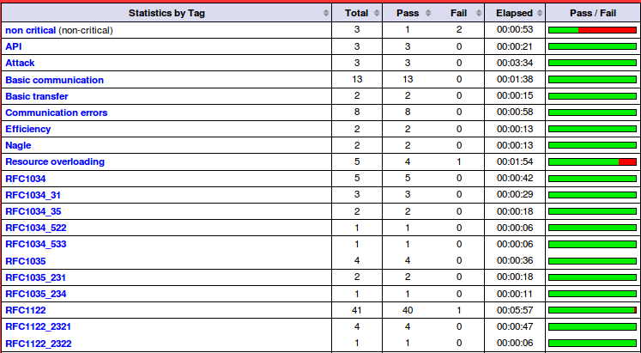

Slide 5

Introduction to Robot Framework

Slide 6
Introduction to RF - Facts
Some facts
Lightweight test framework
Python module (python 2)
Developed @ Nokia Siemens Networks
Since V2.0 open source (Apache License 2.0)
Hosted on github since 2014 https://github.com/robotframework/robotframework
Very good user documentation: http://robotframework.org/robotframework/

Slide 7
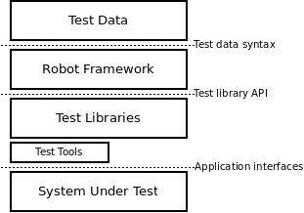
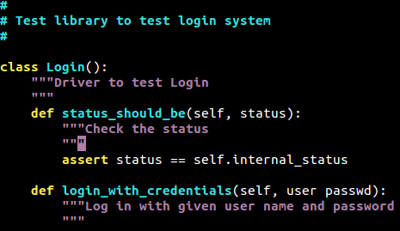
Introduction to RF - Architecture
Test Data
Test case | Action | Argument | Argument
Login with invalid password | Open login page
 | Login with credentials | username
 | Status should be | Access denied
Flow regulator | Set gas flow to | 10
 | Gas flow should be between | 5 | 15
RF tools (testdoc, libdoc, RIDE,...)
Your own tools

Slide 8
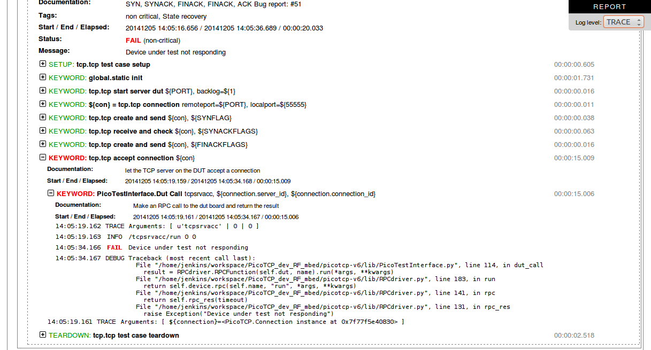
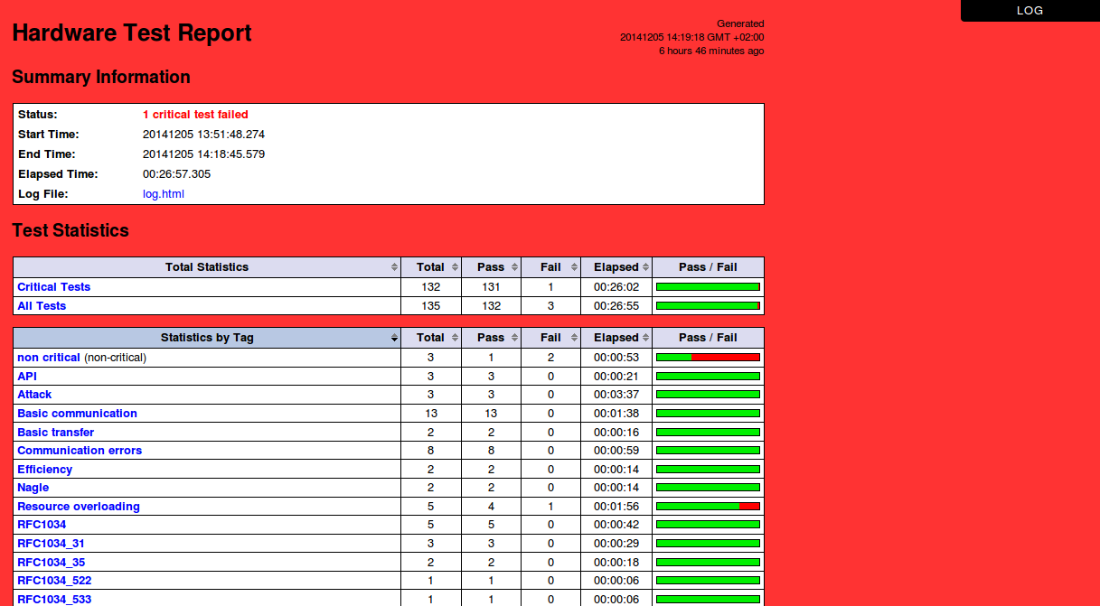
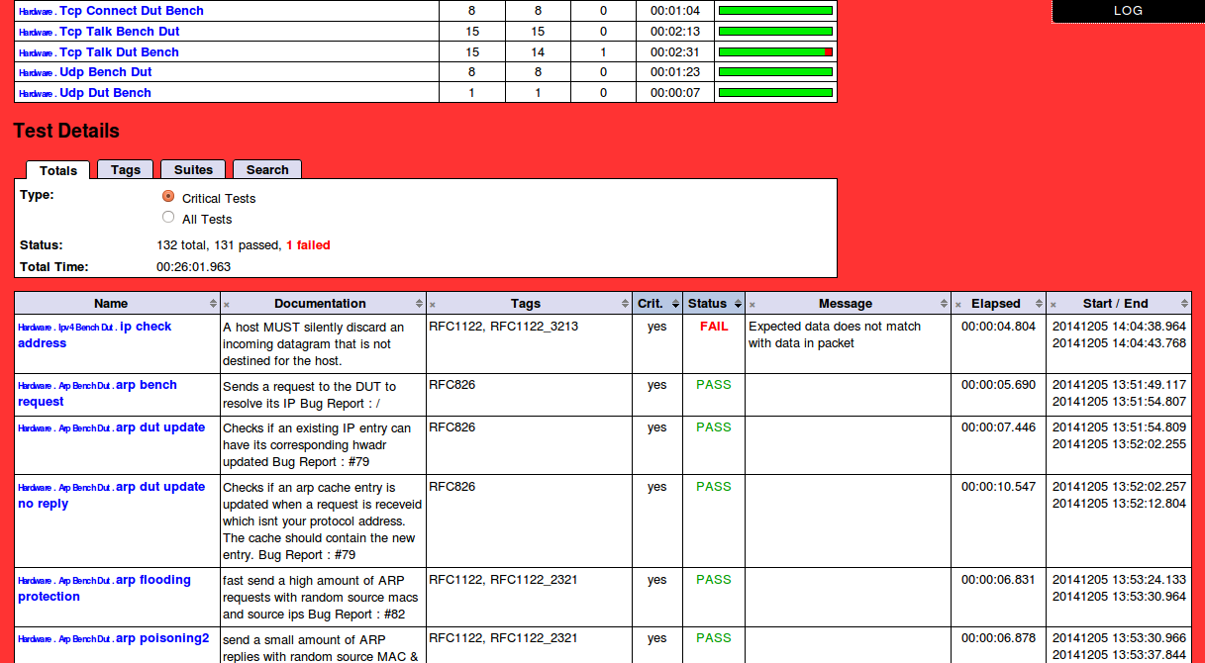
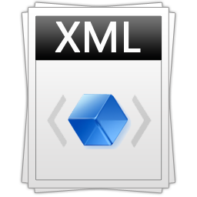
Introduction to RF - Reporting

Slide 9
Introduction to RF - Test libraries
Standard test libraries
BuiltIn
OperatingSystem
Collections
String
XML
Process
DateTime
Available test libraries
Selenium(2)Library (web GUI)
watir-robot (web GUI)
SwingLibrary (Java GUI)
AutoItLibrary (general Windows GUI)
DatabaseLibrary (Generic Database Interfaces)
SSHLibrary (SSH and SFTP)
HTTP test library (WebTest or Requests)
AndroidLibrary (Calabash Android)
IOSLibrary (Calabash iOS)
SikuliLibrary (general GUI)

Slide 10
Introduction to RF - Tools
Editing tools
jenkins plugin (plot, status, links to reports)
RobotIDE (RIDE) (full IDE written in python)
Vim plugin (syntax)
Emacs plugin (syntax, search, autocompl.)
Eclipse plugin (syntax, hyperlinks, autocompl.)

Slide 11

Writing test data

Slide 12
Writing test data - Test suite structure
Test cases are created in test case files (.html, .txt, .tsv, .rst)
A test case file automatically creates a test suite
A directory containing test case files forms a higher-level test suite

Slide 13
Writing test data - Test data tables
Table name | Used for
Settings | importing test libraries, resource files, variable files setting metadata defining suite setup/teardown
Variables | common variables that can be used in the test file
Test Cases | list of test cases
Keywords | user defined keywords that can be used in the test file

Slide 14
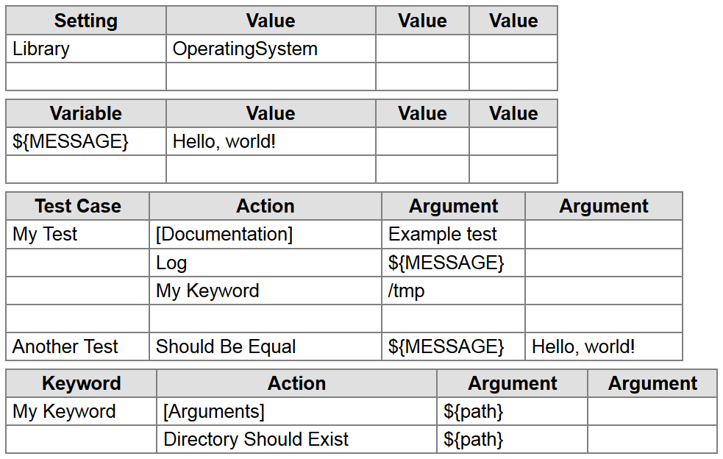
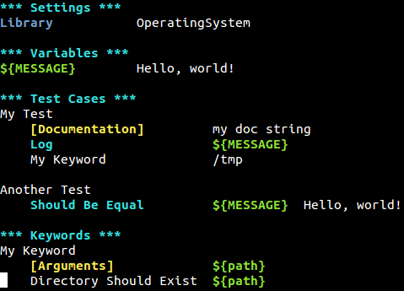
Writing test data - Basic example
graphic format
Plain text format

Slide 15
Writing test data - Failures
*** Test Cases ***
lets fail
Fail
fail at the second keyword
Should be Equal ${1} ${1}
Should Be Equal ${12} ${13}
… msg=Those numbers are not equal (euh...)

Slide 16
Writing test data - Settings
*** Test Cases ***
My test case settings
[Documentation] This documentation will be visible in the report
... and summarizes the goal of the test case
[Tags] spam eggs
[Setup] my setup keyword
Do something
[Teardown] my teardown keyword
A template example
[Template] Calculate stuff
1 + 8 9
1 << 5 32

Slide 17
Writing test data - Settings
*** Settings ***
Documentation Some documentation of this test suite
Default Tags My default tag # Will be removed when a TC has [Tags]
Force Tags RFC793
Test Setup My generic setup keyword
Test Teardown My generic teardown keyword
Suite Setup My generic suite setup keyword
Suite Teardown My generic suite teardown keyword
Test Template My default template keyword

Slide 18
Writing test data - Decisions
Caution, its not a programming language!
*** Test Cases ***
Example one
Run Keyword If ‘${status}’ == ‘PASS’ Some Action arg
Run Keyword Unless ‘${status}’ == ‘PASS’ Another Action
Example two
${rc}= Run Keyword And Ignore Error My keyword
${ret}= Run Keyword If ${rc} == 0 Do action A
... ELSE Do action B
Example three
${rc}= Run Keyword And Ignore Error My keyword
Run Keyword If ${rc} == 0 Do action A
... ELSE IF ${rc} > 0 Do action B
... ELSE Do action C

Slide 19
Writing test data - Loops
Caution, its not a programming language!
*** Test Cases ***
Examples
:FOR ${value} IN @{list}
\ Log ${value} #inside loop
Log done #outside loop
:FOR ${index} IN RANGE ${10}
\ Log ${index}
\ Exit For Loop If ‘${index}’ == ‘${5}’

Slide 20
Writing test data - Arguments
Arguments in keyword names - user defined keywords only!
*** Settings ***
Library OperatingSystem
*** Test Cases ***
Create a file
I execute "touch" with "hello.txt"
Calculate stuff
The result of 1 + 8 should be 9
The result of 1 << 5 should be 32
*** Keywords ***
I execute "${cmd}" with "${opts}"
Run ${cmd} ${opts}
The result of ${calculation} should be ${expected}
${result}= Evaluate ${calculation}
${expected}= Convert To Integer ${expected}
Should Be Equal ${result} ${expected}

Slide 21
Writing test data - Behavior driven
Writing ‘executable requirements’
*** Test Cases ***
bdd style test case
Given login page is open
When username "myname" and password "mypass" are inserted
And credentials are submitted
Then welcome page should be visible
Given
When
And
Then
*** Keywords ***
login page is open
...
username “${user}” and password “${pass}” are inserted
...
credentials are submitted
...
welcome page should be visible
...

Slide 22
Writing test data - Resource files
Grouping common user keywords and variables
Same as test case file but without test cases
Import it in (multiple) test suites with:
Keep them outside test suites for your convenience
***Settings***
Resource my_resource.txt

Slide 23

Getting started

Slide 24
Getting started - Installing RF
Using pip:
pip install robotframework (--upgrade)
pip install robotframework-selenium2library
From source:
git clone https://github.com/robotframework/robotframework.git
cd robotframework/
python setup.py install
Run a simple example:
pybot my_test_case_file.txt

Slide 25
Getting started - File structure
A possible file structure
├── run.py
├── userlibs
│ ├── PicoTestInterface.py
│ ├── PicoDHCP.py
│ └── ...
├── resources
│ ├── dhcp.txt
│ └── ...
└── testcases
├── suiteX
│ ├── dhcp_client_dora.txt
│ └── ...
└── suiteY
├── ping_linux.txt
└── ping.txt

Slide 26
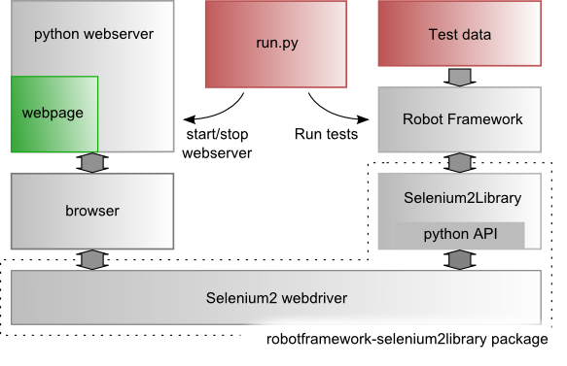
Getting started - Testing a web page

Slide 27
Writing test data - Debugging
Install debug library
pip install robotframework-debuglibrary
Your test case
Interactive shell
> log hello
> get time
< '2011-10-13 18:50:31'
> import library String
> get substring helloworld 5 8
*** Settings ***
Library DebugLibrary
** test case **
some test
# some keywords...
Debug

Slide 28
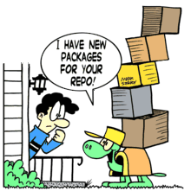
Extending
Robot Framework

Slide 29
Extending RF - Test library API
Module versus Class
Module name = Library name
No support for library args
Keep state by global variables
Global library lifetime scope
Class name = Library name
Support for library args
Keep state in class instance
Custom library lifetime scope

Slide 30
Extending RF - Test library API
Library lifetime scope
TEST_CASE: A new instance for every test case
SUITE_SCOPE: A new instance for every test suite
GLOBAL_SCOPE: One instance for the entire run

Slide 31
Extending RF - Test library API
Library example
class ExampleLibrary:
ROBOT_LIBRARY_SCOPE = 'TEST CASE'
def __init__(self, value=0):
self._counter = value
def count(self):
self._counter += 1
print self._counter
def get_counter(self):
return self._counter
def check_counter(self, value):
assert self._counter == value,\
"Error: wrong value"
*** Settings ***
Library ExampleLibrary ${5}
*** Test Cases ***
Example one
Count
count
Check Counter ${7}
Example two
Check Counter ${5}
${c}= GetCounter

Slide 32
Extending RF - Useful tips
Setting the search path
export PYTHONPATH="/path/to/my/userlibs:/path/to/my/resource_files"
Debugging: setting breakpoints
Usual Robot Framework test library
import pdb
# ...
pdb.set_trace()
# ...
import sys, pdb
# ...
pdb.Pdb(stdout=sys.__stdout__).set_trace()
# ...

Slide 33
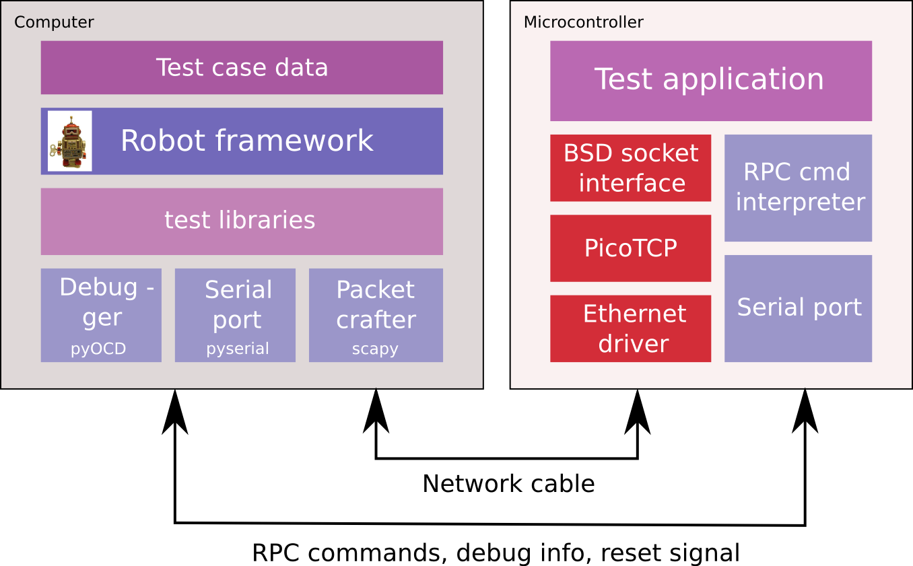
Extending RF - PicoTCP on MCU

Slide 34
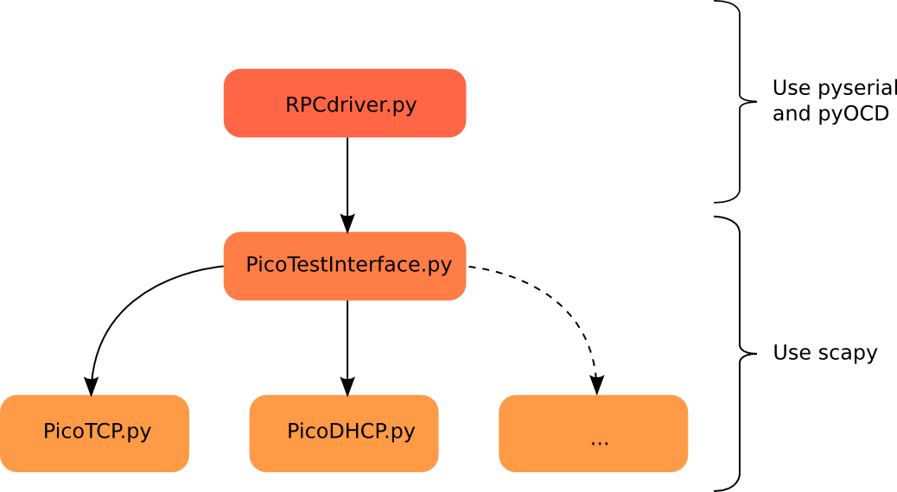
Extending RF - PicoTCP on MCU

Slide 35
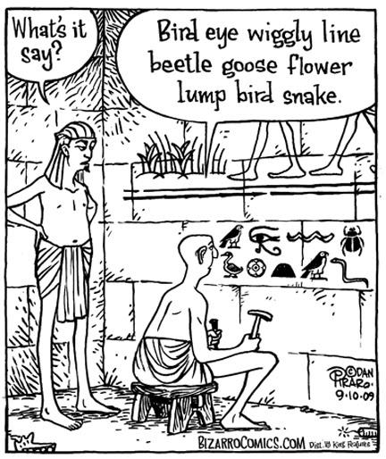
Language support

Slide 36
Language support - Java / C#
Using Jython (java)
Writing test libraries in java -> seamless support
Using IronPython (.NET)
Writing test libraries in C# -> seamless support since RF 2.7

Slide 37
Language support - C / C++
C/C++ - python interface
Write test library in C /C++ with a python interface
Compile test library as shared objects (.so or .dll)
Python-C interface example
#include <Python.h>
static PyObject *spam_system(PyObject *self, PyObject *args)
{
const char *command;
int sts;
if (!PyArg_ParseTuple(args, "s", &command))
return NULL;
sts = system(command);
return Py_BuildValue("i", sts);
}

Slide 38
Language support - C using ctypes
Ctypes -> move language bindings to python code
Write test library in python using ctypes
Compile the C (test) library as a shared object
Python-C interface example
>>> from ctypes import *
>>>
>>> libc = CDLL("libc.so.6")
>>> printf = libc.printf
>>> printf("Hello, %s\n", "World!")
Hello, World!
14

Slide 39
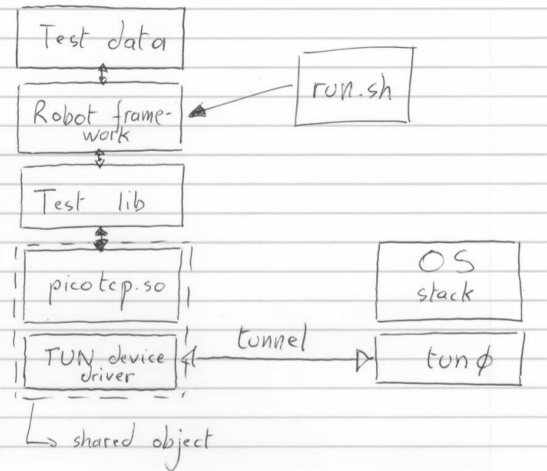
Language support - Ctypes example
Test library for native PicoTCP API

Slide 40
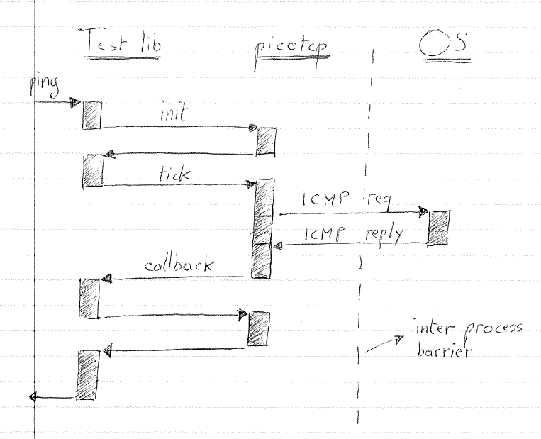
Language support - Ctypes example
Execution flow

Slide 41
Example code
git clone https://github.com/maartenvds/robot-framework-examples.git

Slide 42

Questions

